Slide 1

ABFRL Brand - HometoPDP Flow App Tagging(F21/SC)
17th Oct 2023

Slide 2
Guidelines to Implement Tagging
Adobe Launch SDK should be implemented to trigger the custom events​
​
Copy and paste the contextData as it is without changing the Camel Casing.​
​
All values should be passed in lowercase.​
​
Track State(Page Load Event) and Track Action(Non-Page Load event) should be fired along with the contextData.​
​
Context data should be fired with specific event.​
​
<> this indicates dynamic value to be captured and passed.​
​
Testing will be performed by Implementation Team after ABFRL QA team will give the confirmation/sign off for the testing done by them.​
​
UAT should be done first in staging and then in production post-production UAT adobe’s codes are pushed to live.​
​
Product Category value should be consistent for every product for entire website.​
​
For Customer ID, pass the value only when available else pass it as blank.

Slide 3
Super App Brands
Since Super App contains multiple cross-brands journey, therefore w.r.t to tracking the brand/product brand currently included( PFB the table with the expected value to be passed in the context data)
Brand/Product Brand | Datalayer Value
Van Huesen | vh
Peter England | pe
Allen Solly | as
Louis Phillipe | lp
Reebok | rbk
American Eagle | aeo
Forever 21 | f21
Simon Carter | sc

Slide 4

Generic Tags

Slide 5
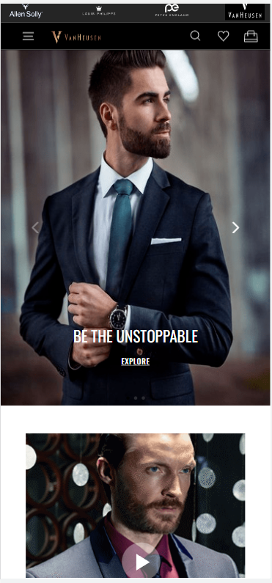
On any banner click

Slide 6
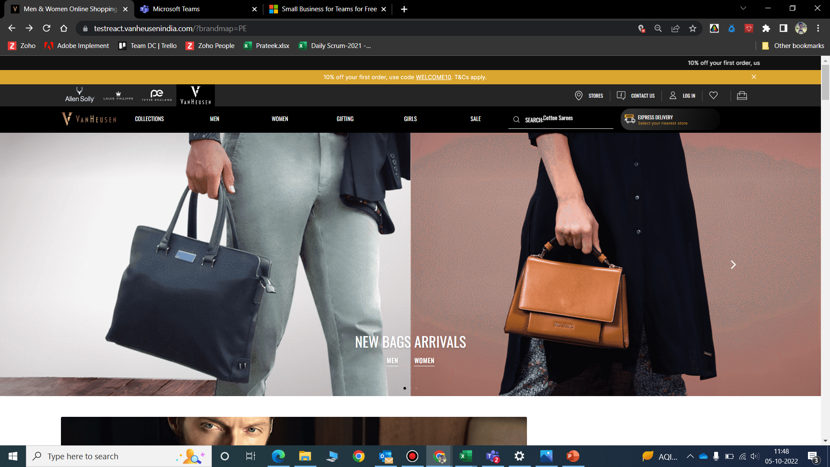
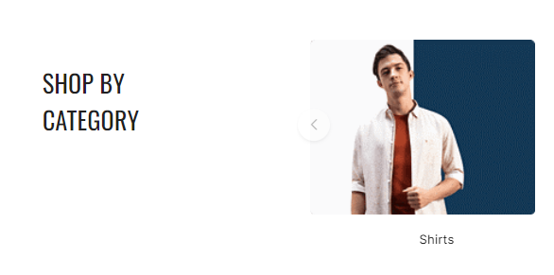
Click Type | Tracking Type | Launch variables | Expected Values
Any Banner click or Widget click | All CTAs | let contextData={ linkName : "banner click", channel: "<android/ios>|<page name without the word "page">", // eg : home, category,etc. customerID : "<customerID>", // only pass when available linkPageName: "<page name>", //the name of the page from where the product was clicked, eg : home page, product listing page , etc. loginStatus : "<logged-in/guest>" , brand: "<brand name>", icid : "<page type>-<brand name>|<banner name>|<widget name>|<cta name>|<banner/widget position>|<banner/widget type>", //if a banner or widget is clicked platform: "<android/ios>", userDetails: "<gender>|<age>", // pass only when user is logged in dob: "<date of birth>" // pass only when user is logged in }; ACPCore.trackAction("banner click", contextData); Expected values : In brand, the expected values are f21 sc | loginStatus may have the values:- logged-in guest icid will be passed when a banner or widget is clicked. icid should always be passed in the given format only. Pass na if any value is missing. Example value :- home page-aoe|new bags arrivals|hero banner|banner click/mens/shop now/widget click|1 home page-sc|shirts|shop by category|banner click|1

Slide 7
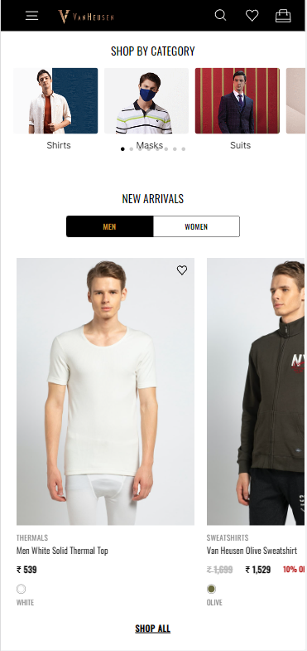
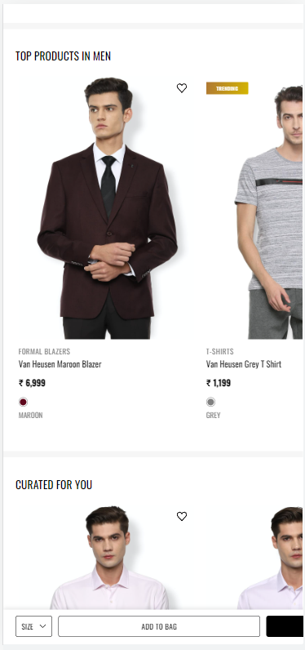
On Any Products click(Home to PDP)

Slide 8
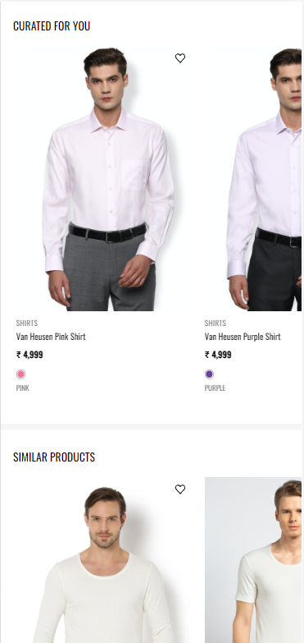

Slide 9
Click Type | Tracking Type | Launch variables | Expected Values
Product clicks | All CTAs | let contextData={ linkName:"product click", channel: "<android/ios>|<page name without the word "page">", // eg : home, category, linkPageName: "<page name>", //the name of the page from where the product was clicked, eg : home page, product listing page , etc. customerID : "<customerID>", // only pass when available loginStatus : "<logged-in/guest>" , brand: "<brand name>", &&products : ";<product id>;;;;eVar19 = <product category>|eVar30=<product name>| eVar32=<product 1 brand name>|eVar33=<product stock status>|eVar23=<product position>", pfm : "<section of the page/ product finding source>", platform: "<android/ios>", userDetails: "<gender>|<age>", // pass only when user is logged in dob: "<date of birth>" // pass only when user is logged in }; ACPCore.trackAction("product click", contextData); | loginStatus may have the values:- logged-in guest pfm means product finding method, the expected values will be the section of the page from where the user has found the product. Eg : "home product slider" "internal search" "internal campaign" "similar products" "top picks" "breadcrumb" "navigation/browsing" "promos" "wishlist/favorites" "collections" "cross-Sell" "campaign landing pages" stockStatus: provide whether product is in stock or out of stock eg – stockStatus : "out of stock" or "available" size: example values:- 42 L In brand, the expected values are f21 sc

Slide 10
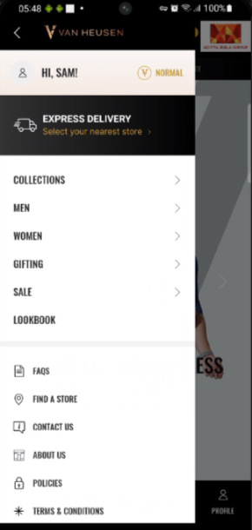
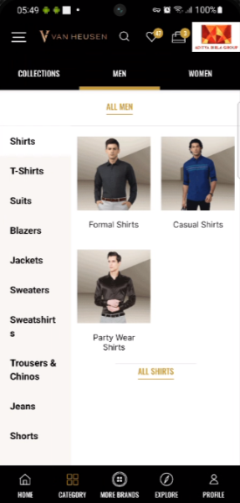
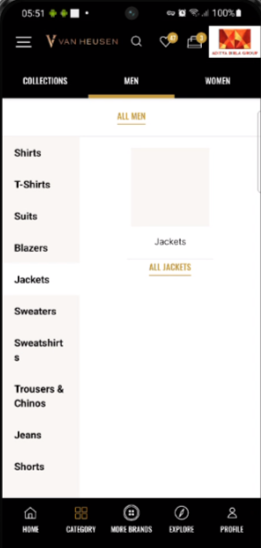
Menu Navigation Tracking

Slide 11
Click Type | Tracking Type | Launch variables | Expected Values
Menu-tracking | All CTAs | digitalData={ linkName:"<cta name>", channel: "<web/msite>|<page name from which menu is clicked without the word “page”>", // eg : home, category, customerID : "<customerID>", // only pass when available linkPageName: “<page name>", //the name of the page from where menu was clicked, eg : home page, plp, pdp brand: “<brand name>”, menuNav: "<level1:level1:level3>" loginStatus : "<logged-in/guest>" , platform: "<desktop website/mobile website>", userDetails: "<gender>|<age>", // pass only when user is logged in dob: "<date of birth>" // pass only when user is logged in }; ACPCore.trackAction("<cta name>", contextData); In brand, the expected values are f21 sc | loginStatus may have the values:- logged-in guest <ctaName> will be the product category clicked, eg : polo T shirts, men, accessories In menuNAV, the expected values will be like level1- when user clicks on collection, men, women, sale, gifting, etc then menuNav value will be: men , women level2- when user clicks on shirts, tshirts, shuits, accessories, etc then menuNav value will be: men:shirts Men:wallets level3- when user clicks on casual shirts,formal blazers,socks , etc then menuNav value will be: Men: suits: formal suits Men:accessories:socks

Slide 12
Home Page

Slide 13
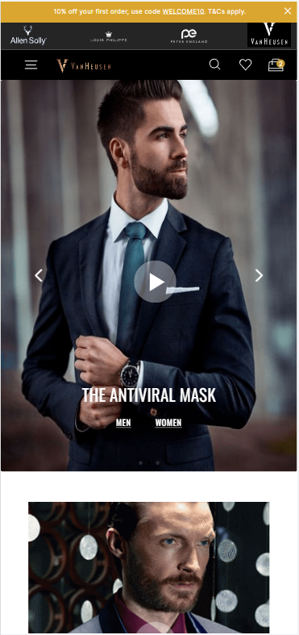
On Home page load

Slide 14
Page Type | Tracking Type | Launch variables | Expected Values
Home page | onload | let contextData={ pageName: "home page", channel: "<android/ios>|home", brand: "<brand name>", customerID : "<customerID>", // only pass when available loginStatus : "<logged-in/guest>" , pageType : "<brand name>-home page" platform: "<android/ios>", &&events: "event60", userDetails: "<gender>|<age>", // pass only when user has logged in dob: "<date of birth>" // pass only when user has logged in }; ACPCore.trackState("home page", contextData); | loginStatus may have the values:- logged-in guest In pageType ,brand name may have the below values:- f21 sc In brand, the expected values are f21 sc

Slide 15
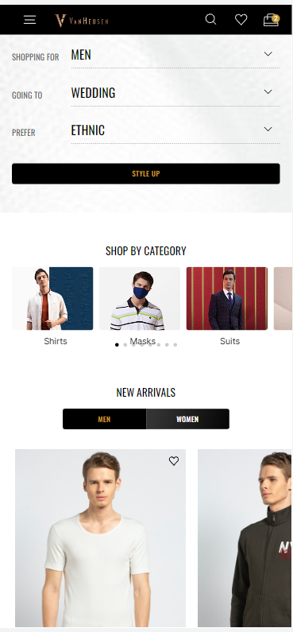
On Home page buttons click (excluding banner and product clicks)

Slide 16
Click Type | Tracking Type | Launch variables | Expected Values
Buttons click | All CTAs | let contextData={ linkName:"<cta name>", channel: "<android/ios>|home", linkPageName: "home page", brand: "<brand name>", customerID : "<customerID>", // only pass when available loginStatus : "<logged-in/guest>" , platform: "<android/ios>", userDetails: "<gender>|<age>", // pass only when user is logged in dob: "<date of birth>" // pass only when user is logged in }; ACPCore.trackAction("<cta name>", contextData); | loginStatus may have the values:- logged-in guest this will capture button clicks only, apart from banner clicks & product clicks. In brand, the expected values are f21 sc

Slide 17
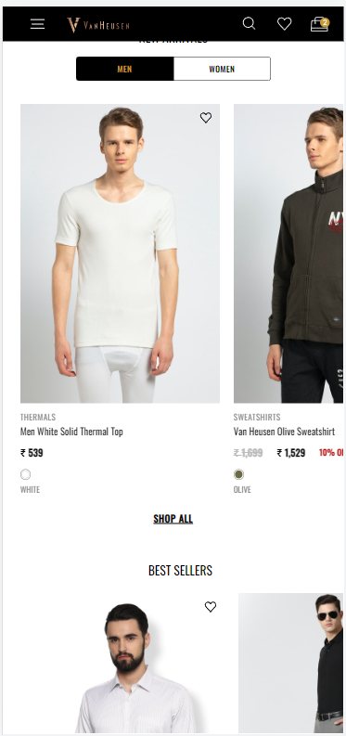
On Home page wishlist click

Slide 18
Click Type | Tracking Type | Launch variables | Expected Values
Add to wishlist | Icon | let contextData={ linkName: "<add to wishlist/remove from wishlist>", channel: "<android/ios>|home", linkPageName: "home page", brand: "<brand name>", customerID : "<customerID>", // only pass when available loginStatus : "<logged-in/guest>", &&events: "<event4/event5>", // event4 only when add to Wishlist and event5 only when remove from Wishlist &&products : ";<product id>;;;;eVar19 = <product category>|eVar30=<product name>| eVar32=<product 1 brand name>, platform: "<android/ios>", userDetails: "<gender>|<age>", // pass only when user is logged in dob: "<date of birth>" // pass only when user is logged in }; ACPCore.trackAction("<add to wishlist/remove from wishlist>",contextData); | loginStatus may have the values:- logged-in guest In brand, the expected values are f21 sc productID: will have the value of SKU ID of the product. productCategory: will have the category of the product. Example:- shirt trouser productName: name of the product.

Slide 19
Category Page

Slide 20
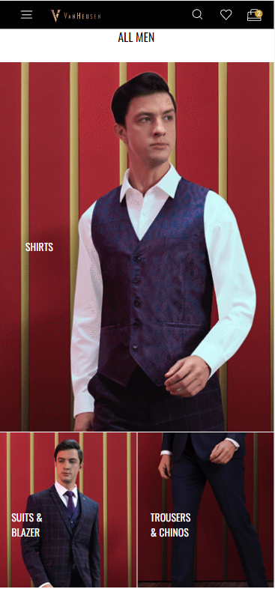
On Category page load

Slide 21
Page Type | Tracking Type | Launch variables | Expected Values
Category | onload | let contextData={ pageName: "category page", channel: "<android/ios>|category", customerID : "<customerID>", // only pass when available loginStatus : "<logged-in/guest>" , brand: "<brand name>", pageType : "<brand name> – category page" platform: "<android/ios>", userDetails: "<gender>|<age>", // pass only when user has logged in dob: "<date of birth>" // pass only when user has logged in }; ACPCore.trackState("category page", contextData); | loginStatus may have the values:- logged-in guest In brand, the expected values are F21 sc brand name may have the below values:- f21 sc

Slide 22
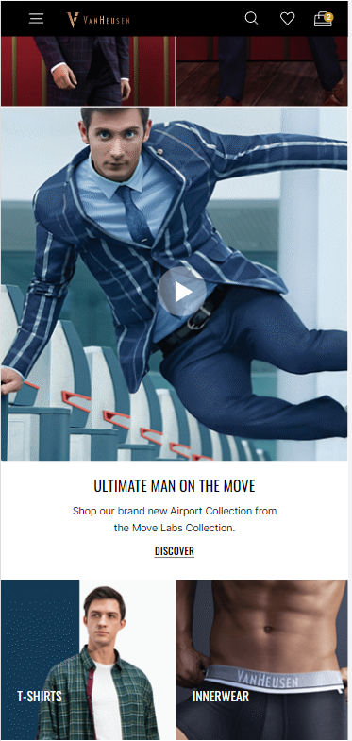
On Category page, all CTAs

Slide 23
Click Type | Tracking Type | Launch variables | Expected Values
Category page CTA clicks | All CTAs | let contextData={ linkName:"<cta name>", channel: "<android/ios>|category", linkPageName: "category page", brand: "<brand name>", customerID : "<customerID>", // only pass when available loginStatus : "<logged-in/guest>" , platform: "<android/ios>", userDetails: "<gender>|<age>", // pass only when user is logged in dob: "<date of birth>" // pass only when user is logged in }; ACPCore.trackAction("<cta name>", contextData); | loginStatus may have the values:- logged-in guest In brand, the expected values are f21 sc

Slide 24
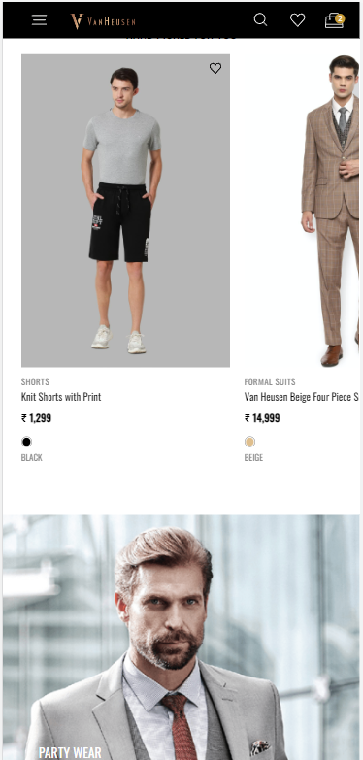
Category page Add to Wishlist

Slide 25
Click Type | Tracking Type | Launch variables | Expected Values
Add to wishlist | Icon | let contextData={ linkName: "<add to wishlist/remove from wishlist>", channel: "<android/ios>|category", linkPageName: "category page", brand: "<brand name>", customerID : "<customerID>", // only pass when available loginStatus : "<logged-in/guest>" , &&events: "<event4/event5>", // event4 only when add to Wishlist and event5 only when remove from Wishlist &&products : ";<product id>;;;;eVar19 = <product category>|eVar30=<product name>| eVar32=<product 1 brand name>, platform: "<android/ios>", userDetails: "<gender>|<age>", // pass only when user is logged in dob: "<date of birth>" // pass only when user is logged in }; ACPCore.trackAction("<add to wishlist/remove from wishlist>", contextData); | loginStatus may have the values:- logged-in guest productID: will have the value of SKU ID of the product. productCategory: will have the category of the product. Example:- shirt Trouser productName: name of the product. In brand, the expected values are f21 sc

Slide 26
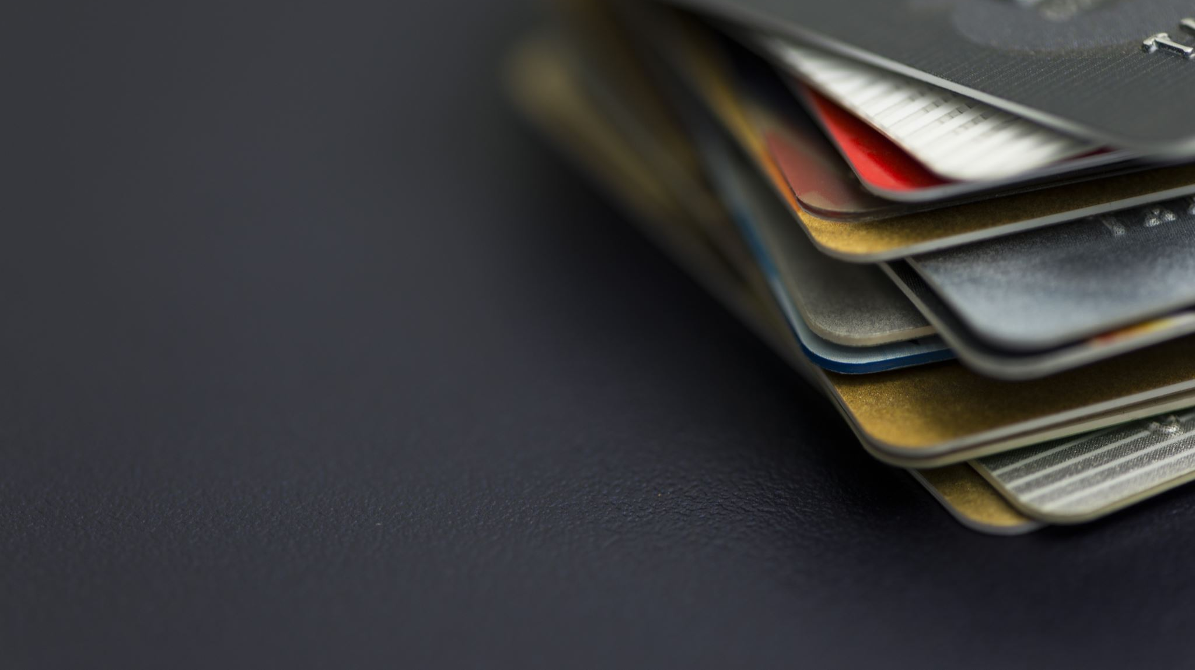
PLP

Slide 27
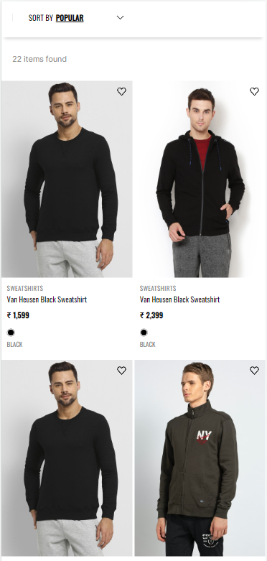
On Load of Product listing page

Slide 28
Page Type | Tracking Type | Launch variables | Expected Values
Category page | onLoad | let contextData={ pageName: "product listing page", channel: "<android/ios>|product listing", brand: "<brand name>", customerID : "<customerID>", // only pass when available loginStatus : "<logged-in/guest>" , pageType : "<brand name>-product listing page" platform: "<android/ios>", &&events: "event9", plpID : "<PLP ID>" //pass the PLP ID of that listing page,​ plpProductCategory : "products category",​ productCount:"<number of product count>", userDetails: "<gender>|<age>", // pass only when user has logged in dob: "<date of birth>" // pass only when user has logged in }; ACPCore.trackState("product listing page", contextData); | loginStatus may have the values:- logged-in guest brand name may have the below values:- f21 sc In brand, the expected values are f21 sc

Slide 29
PLP Add to wishlist

Slide 30
Click Type | Tracking Type | Launch variables | Expected Values
Add to wishlist | Icon | let contextData={ linkName: "<add to wishlist/remove from wishlist>", channel: "<android/ios>|product listing", linkPageName: "product listing page", brand: "<brand name>", customerID : "<customerID>", // only pass when available loginStatus : "<logged-in/guest>" , &&events: "<event4/event5>", // event4 only when add to Wishlist and event5 only when remove from Wishlist &&products : ";<product id>;;;;eVar19 = <product category>|eVar30=<product name>| eVar32=<product 1 brand name>, platform: "<android/ios>", userDetails: "<gender>|<age>", // pass only when user is logged in dob: "<date of birth>" // pass only when user is logged in }; ACPCore.trackAction("<add to wishlist/remove from wishlist>", contextData); | loginStatus may have the values:- logged-in guest productID: will have the value of SKU ID of the product. productCategory: will have the category of the product. Example:- shirt Trouser productName: name of the product. In brand, the expected values are f21 sc

Slide 31
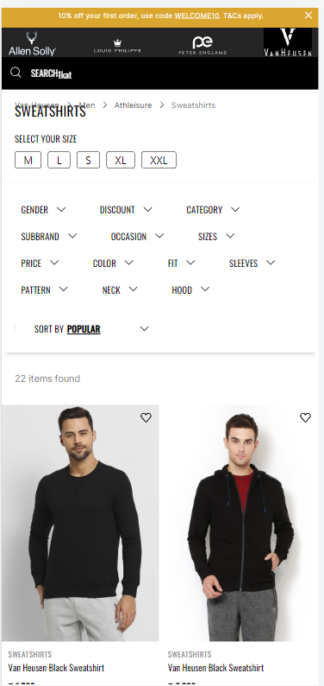
PLP all other CTAs click(excluding products)

Slide 32
Click Type | Tracking Type | Launch variables | Expected Values
Category page cta click | All CTAs | let contextData={ linkName: "<cta name>", channel: "<android/ios>|product listing", linkPageName: "product listing page", brand: "<brand name>", customerID : "<customerID>", // only pass when available loginStatus : "<logged-in/guest>" , plpID : "<PLP ID>" //pass the PLP ID of that particular listing page,​ plpProductCategory : "products category", filterName: "< filter 1 applied,filter 2 applied,…filter N applied>". // only when filter is applied filterValue: "<filter 1 value, filter 2 value,….filter N value>" // only when filter is applied sortBy : "<sort by option>", // only when user has manually sorted. platform: "<android/ios>", userDetails: "<gender>|<age>", // pass only when user is logged in dob: "<date of birth>" // pass only when user is logged in }; ACPCore.trackAction("<cta name>", contextData); | loginStatus may have the values:- logged-in guest In brand, the expected values are f21 sc In filterName, the expected values are gender category sizes color discount subbrand occasion price fit sleeves E.g. "gender, category, sizes, color" In filterValue, the expected values are men formal shirt 42 green women reebok sport v dot E.g. "men, formal shirt, 42, green" In sortBy, expected values are popular new arrivals Discount

Slide 33
PDP

Slide 34
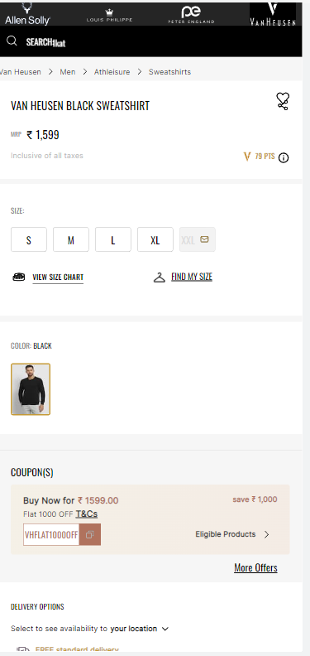
On PDP load

Slide 35
Page Type | Tracking Type | Launch variables | Expected Values
Product page | onLoad | let contextData={ pageName: "product page", channel: "<android/ios>|product", brand: "<brand name>", customerID : "<customerID>", // only pass when available loginStatus : "<logged-in/guest>", pageType : "<brand name>-product page", &&events: "prodView,event11, event13, event14, event15", &&products : ";<product id>;;; event13=<product 1 mrp>| event14=<product 1 selling price>| event15=<product discount amount>;eVar19 = <product category>|eVar30=<product name>|eVar32=<product brand name>|eVar33=< product stock Status>|eVar34= <product color>|eVar36=< product genderType>|eVar44=<product style code>", platform: "<android/ios>", userDetails: "<gender>|<age>", // pass only when user has logged in dob: "<date of birth>" // pass only when user has logged in }; ACPCore.trackState("product page", contextData); | loginStatus may have the values:- logged-in guest In brand, the expected values are f21 sc productID: will have the value of SKU ID of the product. productCategory: will have the category of the product. Example:- Shirt Trouser productMarkPrice: will contain the MRP of the product. productSellPrice: will contain the actual selling price of the product. productName: name of the product. brandName: name of the brand of the product. stockStatus: it will show the quantity of the product available in the stock. color: example values: Red. size: example values:- 42 L styleCode: will contain the style code of the product. Example value:- PESFONUB236782 productDiscount will have the discount applied on the product. productGenderType Example value:- Female

Slide 36
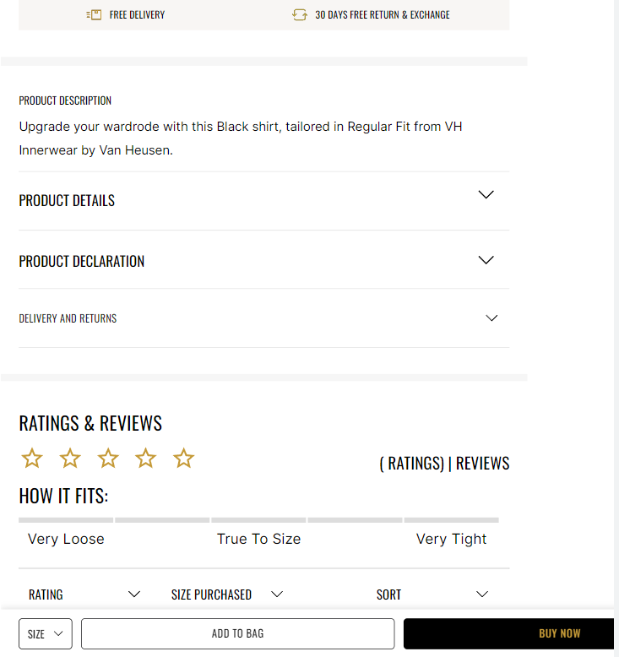
On clicking on Buy Now/ Add to bag

Slide 37
Click Type | Tracking Type | Launch variables | Expected Values
Buy now/ Add to bag | Button | let contextData={ linkName: "<buy now/add to bag>", channel: "<android/ios>|product", linkPageName: "product page", brand: "<brand name>", customerID : "<customerID>", // only pass when available loginStatus : "<logged-in/guest>" , &&events: "scAdd, event13, event14, event15, event61", &&products : ";<product id>;;;event13=<product marked price>|event14=<product selling price>|event15=<product discount amount>|event61=<product quantity>;eVar19 = <product category>|eVar30=<product name>|eVar32=<product brand name>|eVar33=< product stock Status>|eVar34= <product color>|eVar35=<product size>|eVar36=< product genderType>|eVar44=<product style code>", platform: "<android/ios>", userDetails: "<gender>|<age>", // pass only when user is logged in dob: "<date of birth>" // pass only when user is logged in }; ACPCore.trackAction("<buy now/add to bag>",contextData); | loginStatus may have the values:- logged-in guest In brand, the expected values are f21 sc productID: will have the value of SKU ID of the product. productCategory: will have the category of the product. Example:- Shirt Trouser productMarkPrice: will contain the MRP of the product. productSellPrice: will contain the actual selling price of the product. productQuantity: will have the quantity selected for the product. productName: name of the product. brandName: name of the brand of the product. stockStatus: it will show the quantity of the product available in the stock. color: example values: Red. size: example values:- 42 L styleCode: will contain the style code of the product. Example value:- PESFONUB236782 productDiscount will have the discount applied on the product. productGenderType Example value:- Female

Slide 38
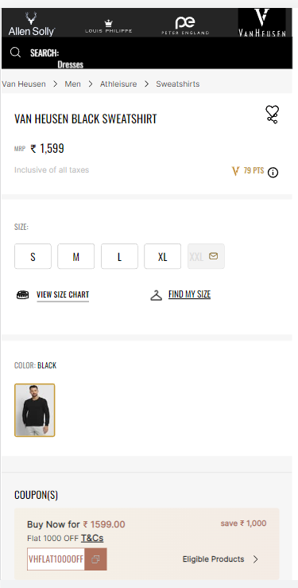
All CTA clicks(except buy now,add to bag,wishlist)

Slide 39
Click Type | Tracking Type | Launch variables | Expected Values
Product page clicks | All CTAs | let contextData={ linkName: "<cta name>", channel: "<android/ios>|product", linkPageName: "product page", brand: "<brand name>", customerID : "<customerID>", // only pass when available loginStatus : "<logged-in/guest>" , platform: "<android/ios>", userDetails: "<gender>|<age>", // pass only when user is logged in dob: "<date of birth>" // pass only when user is logged in }; ACPCore.trackAction("<cta name>", contextData); | //pass this on all CTAs clicks except for click on buy now, add to bag and add to wishlist. loginStatus may have the values:- logged-in guest In brand, the expected values are f21 sc //consider click call for product details and description only when user clicks to open the product details, product declaration & delivery and return drop down menus. Don’t pass when user closes them.

Slide 40
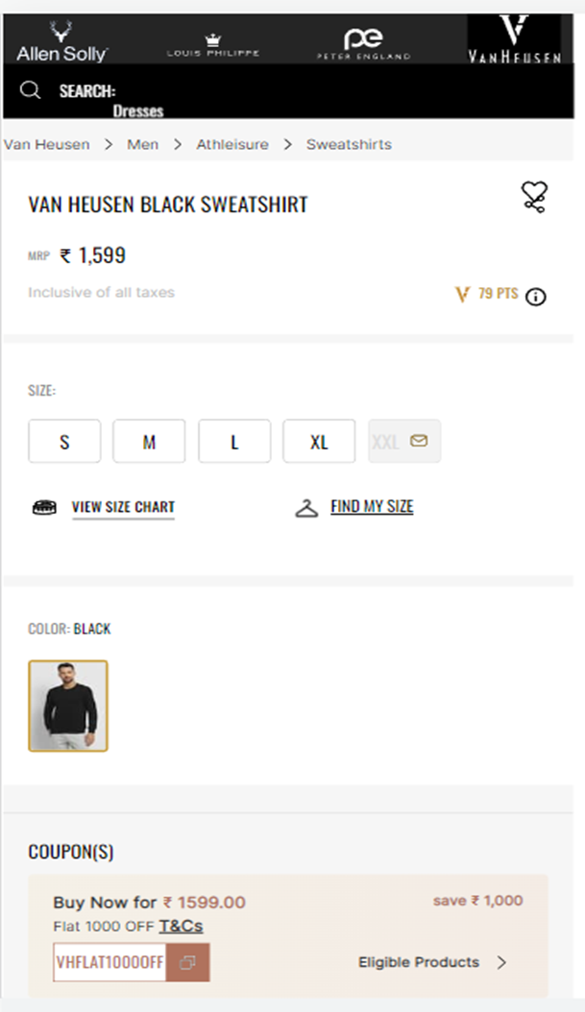
Click on Add to wishlist

Slide 41
Click Type | Tracking Type | Launch variables | Expected Values
Add to wishlist | Button | let contextData={ linkName: "<add to wishlist/remove from wishlist>", channel: "<android/ios>|product", linkPageName: "product page", brand: "<brand name>", customerID : "<customerID>", // only pass when available loginStatus : "<logged-in/guest>" , &&events: "<event4/event5>", // event4 only when add to Wishlist and event5 only when remove from Wishlist &&products : ";<product id>;;;;eVar19 = <product category>|eVar30=<product name>| eVar32=<product 1 brand name>, platform: "<android/ios>", userDetails: "<gender>|<age>", // pass only when user is logged in dob: "<date of birth>" // pass only when user is logged in }; ACPCore.trackAction("<add to wishlist/remove from wishlist>", contextData); | loginStatus may have the values:- logged-in guest In brand, the expected values are f21 sc productID: will have the value of SKU ID of the product. productCategory: will have the category of the product. Example:- Shirt Trouser productName: name of the product.

Slide 42
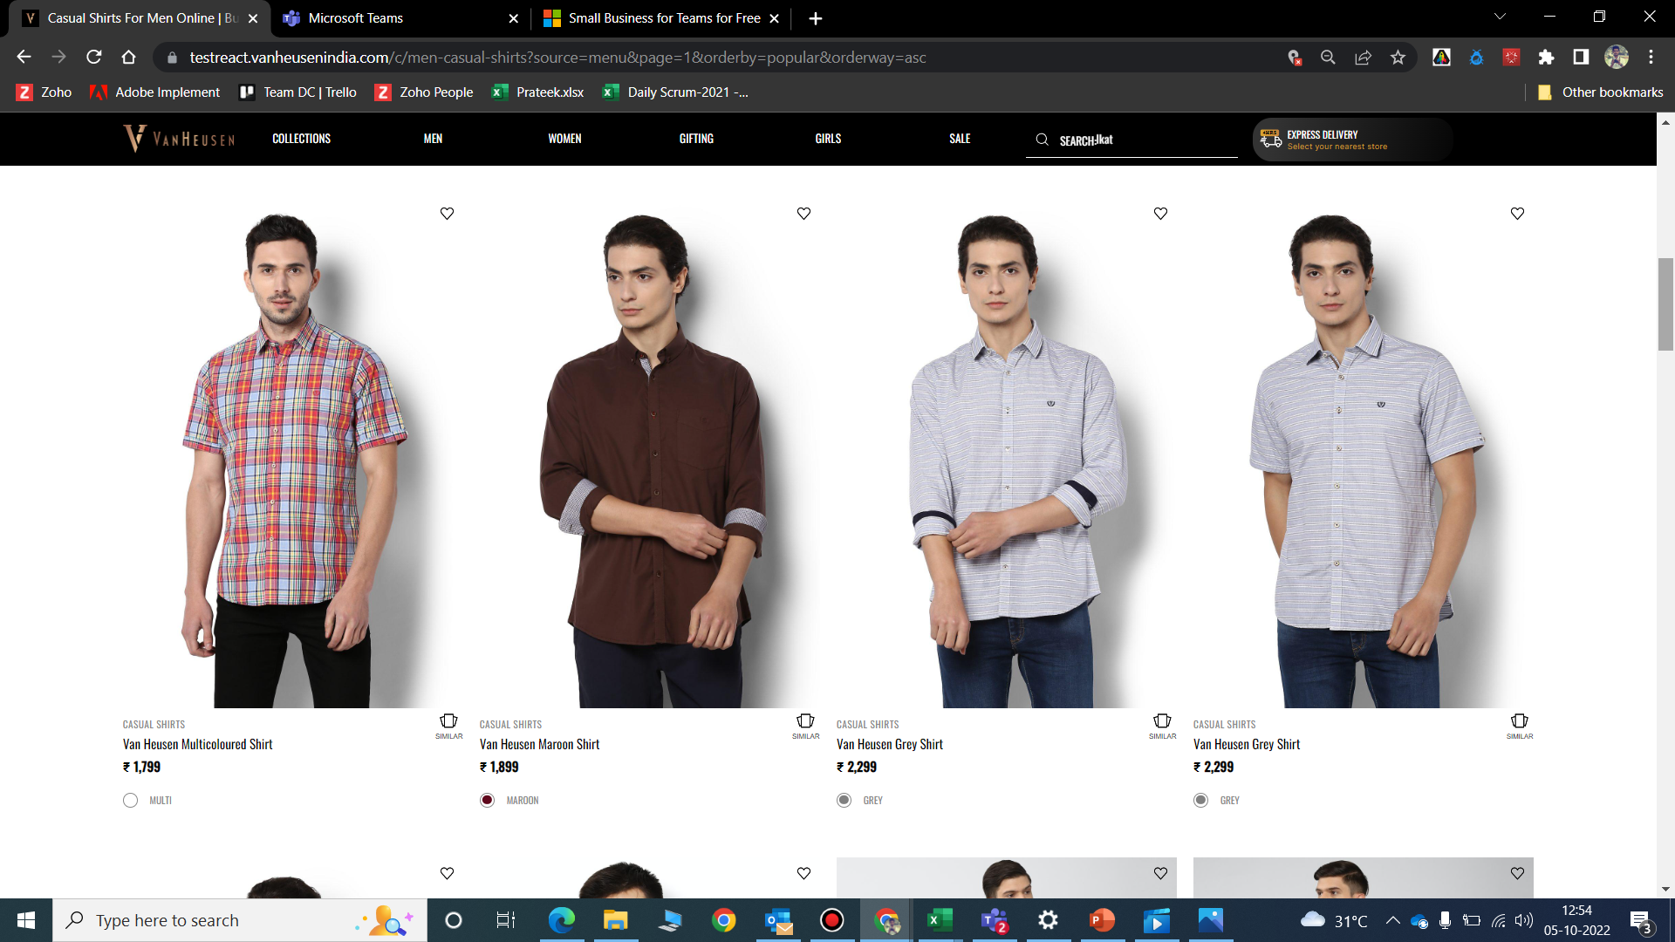
PDP Add to wishlist

Slide 43
Click Type | Tracking Type | Launch variables | Expected Values
Add to wishlist | Icon | let contextData={ linkName: "<add to wishlist/remove from wishlist>", channel: "<android/ios>|product", linkPageName: "product page", brand: "<brand name>", customerID : "<customerID>", // only pass when available loginStatus : "<logged-in/guest>", &&events: "<event4/event5>", // event4 only when add to Wishlist and event5 only when remove from Wishlist &&products : ";<product id>;;;;eVar19 = <product category>|eVar30=<product name>| eVar32=<product 1 brand name>, platform: "<android/ios>", userDetails: "<gender>|<age>", // pass only when user is logged in dob: "<date of birth>" // pass only when user is logged in }; ACPCore.trackAction("<add to wishlist/remove from wishlist>",contextData); | loginStatus may have the values:- logged-in guest In brand, the expected values are f21 sc productID: will have the value of SKU ID of the product. productCategory: will have the category of the product. Example:- shirt Trouser productName: name of the product.

Slide 44
PDP Similar products

Slide 45
Click Type | Tracking Type | Launch variables | Expected Values
View similar | Button | let contextData={ linkName: "similar products click", channel: "<android/ios>|product", linkPageName: "product page", brand: "<brand name>", customerID : "<customerID>", // only pass when available loginStatus : "<logged-in/guest>" , platform: "<android/ios>", userDetails: "<gender>|<age>", // pass only when user is logged in dob: "<date of birth>" // pass only when user is logged in }; ACPCore.trackAction("similar products click", contextData); | loginStatus may have the values:- logged-in guest In brand, the expected values are f21 sc

Slide 46
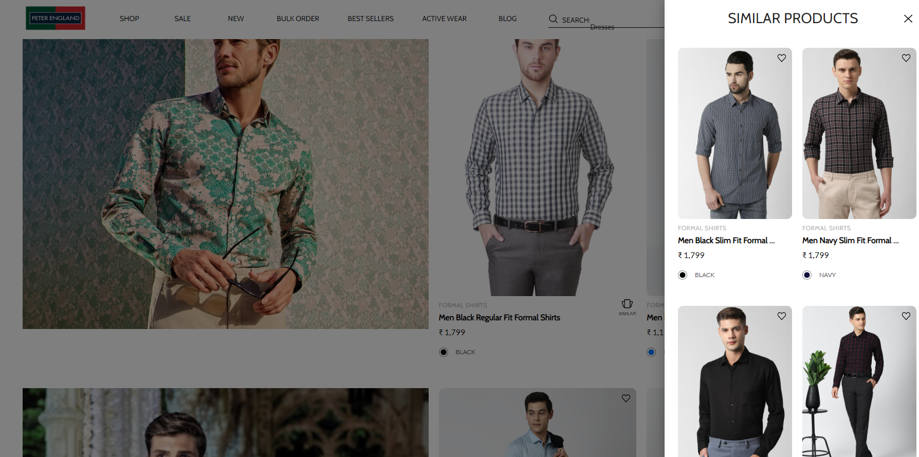
On showing similar products

Slide 47
Page Type | Tracking Type | Launch variables | Expected Values
Similar Product Page | View | let contextData={ pageName: "similar products", parentPage: "product page" channel: "<android/ios>|product", brand: "<brand name>", customerID : "<customerID>", // only pass when available loginStatus : "<logged-in/guest>" , pageType : "<brand name>-product page", &&events: "event6", &&products : ";<product id>;;;;eVar19 = <product category>|eVar30=<product name>, platform: "<android/ios>", userDetails: "<gender>|<age>", // pass only when user has logged in dob: "<date of birth>" // pass only when user is logged in }; ACPCore.trackState("similar products", contextData); // the products info passed here will the info of the product for whom similar products were available. | loginStatus may have the values:- logged-in guest In brand, the expected values are f21 sc productID: will have the value of SKU ID of the product. productCategory: will have the category of the product. Example:- shirt Trouser productName: name of the product.

Slide 48
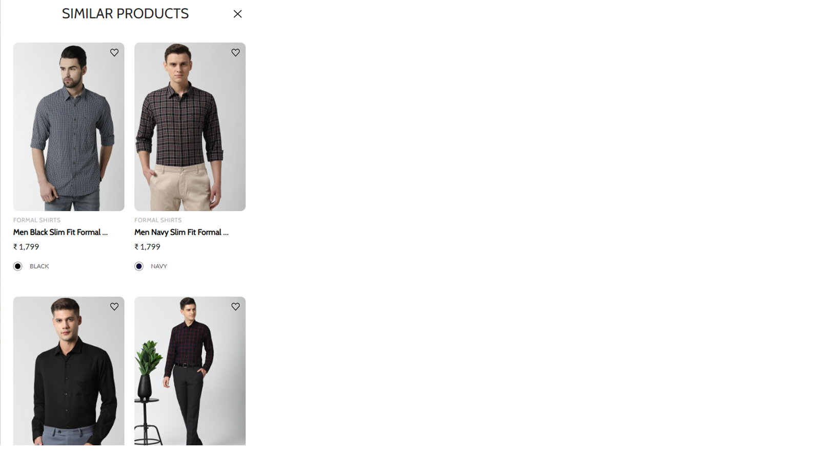
On click of Add to wishlist

Slide 49
Click Type | Tracking Type | Launch variables | Expected Values
Add to wishlist | icon | let contextData={ linkName: "<add to wishlist/remove from wishlist>", channel: "<android/ios>|product", linkPageName: "similar products", parentPage: "product page", brand: "<brand name>", customerID : "<customerID>", // only pass when available loginStatus : "<logged-in/guest>" , &&events: "<event4/event5>",// event4 only when add to Wishlist and event5 only when remove from Wishlist &&products : ";<product id>;;;;eVar19 = <product category>|eVar30=<product name>| eVar32=<product 1 brand name>, platform: "<android/ios>", userDetails: "<gender>|<age>", // pass only when user is logged in dob: "<date of birth>" // pass only when user is logged in }; ACPCore.trackAction("<add to wishlist/remove from wishlist>", contextData); | loginStatus may have the values:- logged-in guest In brand, the expected values are f21 sc productID: will have the value of SKU ID of the product. productCategory: will have the category of the product. Example:- shirt Trouser productName: name of the product.

Slide 50

On click of Close

Slide 51
Click Type | Tracking Type | Launch variables | Expected Values
Close similar products | icon | let contextData={ linkName: "close-similar products", channel: "<android/ios>|product", linkPageName: "similar products", brand: "<brand name>", parentPage: "product page", customerID : "<customerID>", // only pass when available loginStatus : "<logged-in/guest>" , platform: "<android/ios>", userDetails: "<gender>|<age>", // pass only when user is logged in dob: "<date of birth>" // pass only when user is logged in }; ACPCore.trackAction("close-similar products", contextData); | loginStatus may have the values:- logged-in guest In brand, the expected values are f21 sc

Slide 52
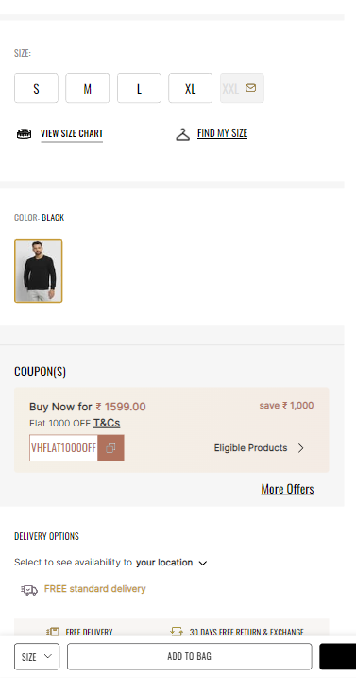
Coupons on Load

Slide 53
Page Type | Tracking Type | Launch variables | Expected Values
Coupon details | pop-up-view | let contextData={ pageName: "coupon pop-up", parentPage: "product page", channel: "<android/ios>|product", brand: "<brand name>", customerID : "<customerID>", loginStatus : "<logged-in/guest>" , pageType : "<brand name>-product page" platform: "<android/ios>", userDetails: "<gender>|<age>", dob: "<date of birth>" }; ACPCore.trackState("coupon pop-up", contextData); | loginStatus may have the values:- logged-in guest In brand, the expected values are f21 sc

Slide 54
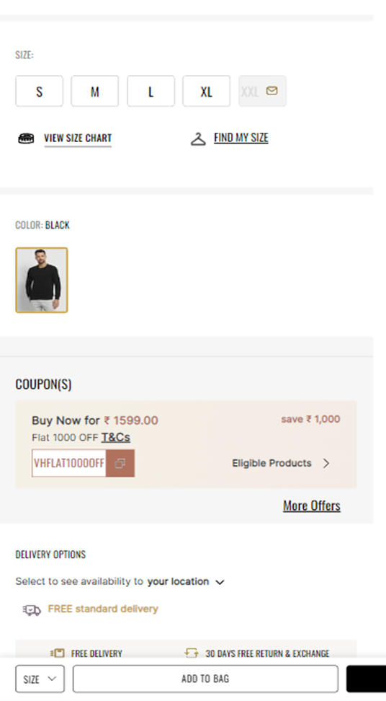
Coupons All CTAs click

Slide 55
Page Type | Tracking Type | Launch variables | Expected Values
Coupon details | CTA | let contextData={ linkName: "<cta name>", channel: "<android/ios>|product", linkPageName: "coupon pop-up", parentPage: "product page", brand: "<brand name>", customerID : "<customerID>", loginStatus : "<logged-in/guest>" , platform: "<brand name>-product page", userDetails: "<gender>|<age>", dob: "<date of birth>", }; ACPCore.trackAction("<cta name>", contextData); | loginStatus may have the values:- logged-in guest In brand, the expected values are f21 sc

Slide 56
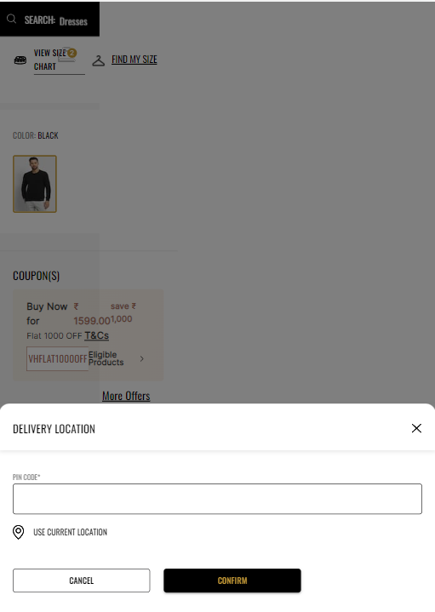
On load Delivery location

Slide 57
Page Type | Tracking Type | Launch variables | Expected Values
Delivery location | onLoad | let contextData={ pageName: "delivery location", parentPage: "product page", channel: "<android/ios>|product", brand: "<brand name>", customerID : "<customerID>", loginStatus : "<logged-in/guest>", pageType : "<brand name>-product page", platform: "<android/ios>", userDetails: "<gender>|<age>", dob: "<date of birth>", }; ACPCore.trackState("delivery location", contextData); | loginStatus may have the values:- logged-in guest In brand, the expected values are f21 sc

Slide 58
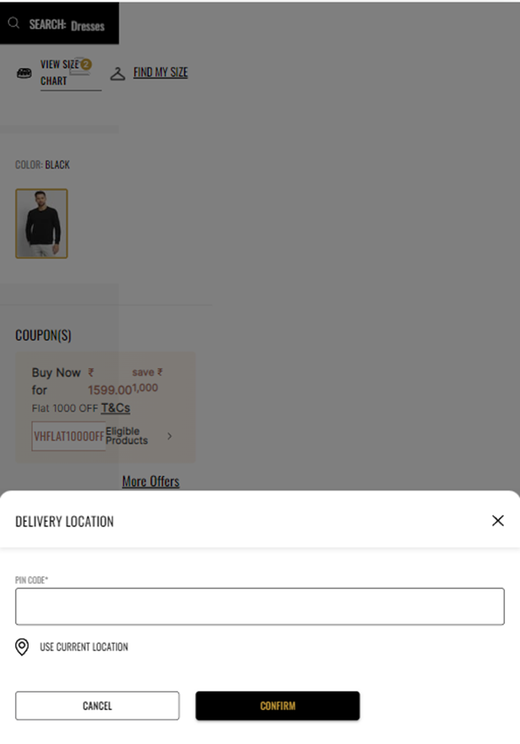
All CTAs clicks

Slide 59
Click Type | Tracking Type | Launch variables | Expected Values
Pincode selection | CTA | let contextData={ linkName:"<cta name>", channel: "<android/ios>|product", linkPageName: "delivery location", parentPage: "product page", brand: "<brand name>", customerID : "<customerID>", loginStatus : "<logged-in/guest>" , platform: "<android/ios>", userDetails: "<gender>|<age>", dob: "<date of birth>", pincode : "<pincode selected>", estDeliveryTime : "<expected delivery time in days>", }; ACPCore.trackAction("<cta name>", contextData); | loginStatus may have the values:- logged-in guest In brand, the expected values are f21 sc

